Slide 1

Florida 2Gen Partnerships to Improve Outcomes for Children, Youth, and Families
Brittany Birken, Ph.D

Slide 2
Florida’s 2Gen Approach
The Florida Children’s Council is the Association of Children’s Services Councils in Florida.
Florida is the only state in the nation with a law enabling communities to create a local government with the sole purpose of investing in children’s services in this manner.

Slide 3
Children’s Services Councils
  Children’s Services Councils:
  Provide funding for children’s programs within the county.
  Make data-driven investments in local children’s programs.
  Seek to maximize local revenue and develop resources.
  Ensure accountability of programs – fiscal & programmatic.

Slide 4
2Gen Approach
There is growing recognition in Florida that systemic approaches are needed to simultaneously address the needs of both families and children in poverty.
The Florida Children’s Council is dedicated to working with strategic leadership and partners to identify more effective policies to improve economic stability and strengthen outcomes for children and families in poverty.

Slide 5
Florida Chamber’s Prosperity Initiative
Partnership with the Florida Chamber of Commerce has been instrumental in getting the complex issues of poverty in the forefront of business leaders and policymakers.
In 2017, the Florida Chamber Foundation published a report outlining the impact of “fiscal cliffs” that occur when a marginal increase in income results in a loss in public benefits, often times leaving families with fewer resources as income increases.
Reflecting prosperity as a core value of the business community and poverty as a critical concern impacting businesses and families alike has positioned the issue on a level previously unachievable.

Slide 6
Florida Chamber’s Prosperity Initiative
The Florida Chamber Foundation has launched an initiative to engage leaders in developing system and policy improvements that includes:
a core advisory body of subject-matter experts;
a series of state level Prosperity Summits;
a data portal to analyze root causes and system links between various co-occurring elements of poverty; and
targeted reports and scorecards that will assist leaders in designing more comprehensive policies that reflect the unique needs of families with young children in poverty.

Slide 7

2Gen Policy Analysis
  The Florida Children’s Council recently published a report with analysis on social services that support families with young children in poverty and aligned policy recommendations.

Slide 8
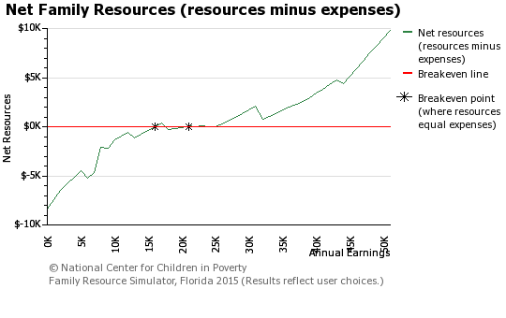
2Gen Policy Analysis

Slide 9
2Gen Policy Analysis

Slide 10
2Gen Policy Analysis
The analysis documented three key benefits cliffs that impede the pathway to economic security for families with young children in poverty:
    Children’s health insurance
    Child care
    Housing

Slide 11
2Gen Policy Analysis
At the heart of the recommendations is how to provide families with a graduated phase out of supports and incorporate workforce services to improve financial outcomes.
The goal is to reduce the need for public supports while improving outcomes for the entire family.

Slide 12
FATES:
Community Demonstration Project
With leadership from Florida Children’s Services Councils, CareerSource Florida, and Early Learning Coalitions in four counties, as well as philanthropic organizations, Florida is now implementing a demonstration project to better integrate child care and workforce services.
The goals are to reduce the number of changes in quality child care, mitigate the cliff effect, and reduce toxic stress by positively impacting parents’ motivation and capacity to improve their economic position and parenting skills.

Slide 13
FATES:
Community Demonstration Project
Within communities, services will be made available to a cohort of families in targeted lower-income neighborhoods that focus on children’s direct experiences including quality and continuity of child care in responsive environments with positive teacher-child interactions.
In tandem, the model will mitigate cliff effects as a critical relief valve for families.

Slide 14
FATES:
Community Demonstration Project
Families eligible for child care subsidy will commit to participating in workforce development services.
Individual workforce plans include sector strategies that align needed workforce supports, but also help identify what child care resources are needed to ensure success for the family.
As part of this effort, a decelerated payment plan is established for phase-out payments to help ease the cliff effect as family income triggers loss of child care subsidies.

Slide 15
Community and State
Focused Strategies
The Florida Children’s Council has worked to create partnerships with business leaders and elected officials on the current challenges for families with young children in poverty.
To advance system development strategies and more effective public policy, both state and community efforts are in place to better support children and families in poverty.

Slide 16

Comments and Questions
Contact Information:
Florida Children’s Council
Brittany Birken, Ph. D, CEO
bbirken@floridacsc.org
850-212-0408
http://flchildrenscouncil.org/

